Slide 1
A novel approach for the evaluation of artificial intelligence on consecutive screening mammograms
S. Pacilè, N. Houssami, P.Fillard
spacile@therapixel.com

Slide 2
Disclosures
Employed at Therapixel

Slide 3
Research Question
Current AI performance evaluations:
MRMC/Standalone
Small dataset
Data enriched with cancer cases
Limited number of negatives
Sensitivity/Specificity – AUC
Biases (laboratory, data-selection, etc.)
Low generalizability
Low interpretability
Performance overestimation
Difficult comparison among studies

Slide 4
Purpose
Proposed evaluation method:
Large dataset (consecutive screens)
Conventional metrics (RR and CDR)
Yearly basis estimation of metrics
Systematic review of cancer cases
Avoid biases
Generalizability
AI’s tool capability to screen-detect breast cancer earlier
More consistent AI/human interaction simulations

Slide 5
Methods
Initial status label assignment
Cancer Positive
Biopsy proven diagnosis within12 months
Cancer Negative
Negative follow-up within 24 months

Slide 6
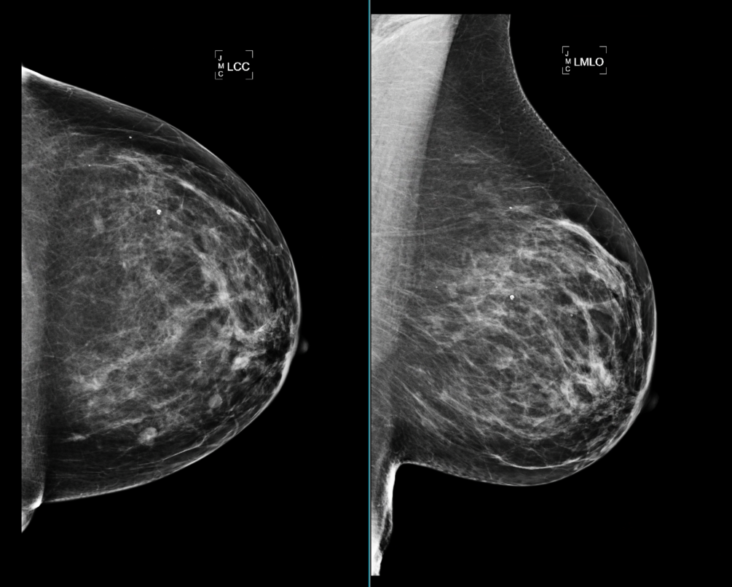
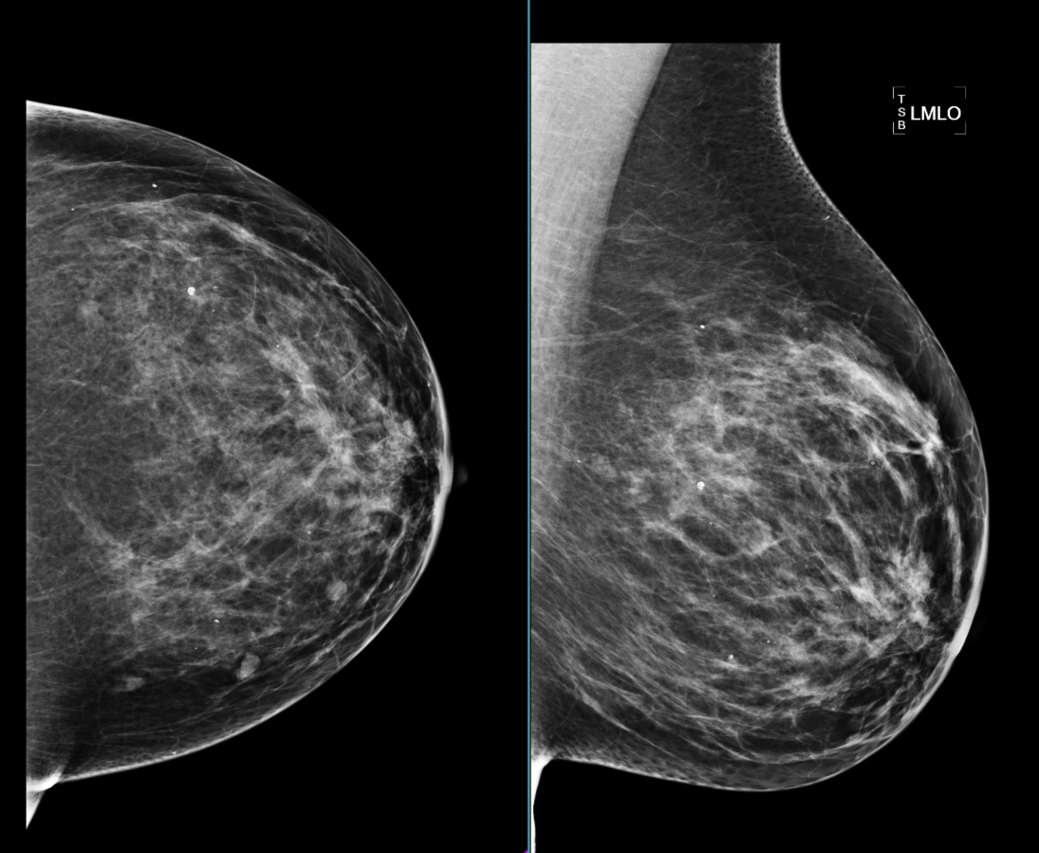
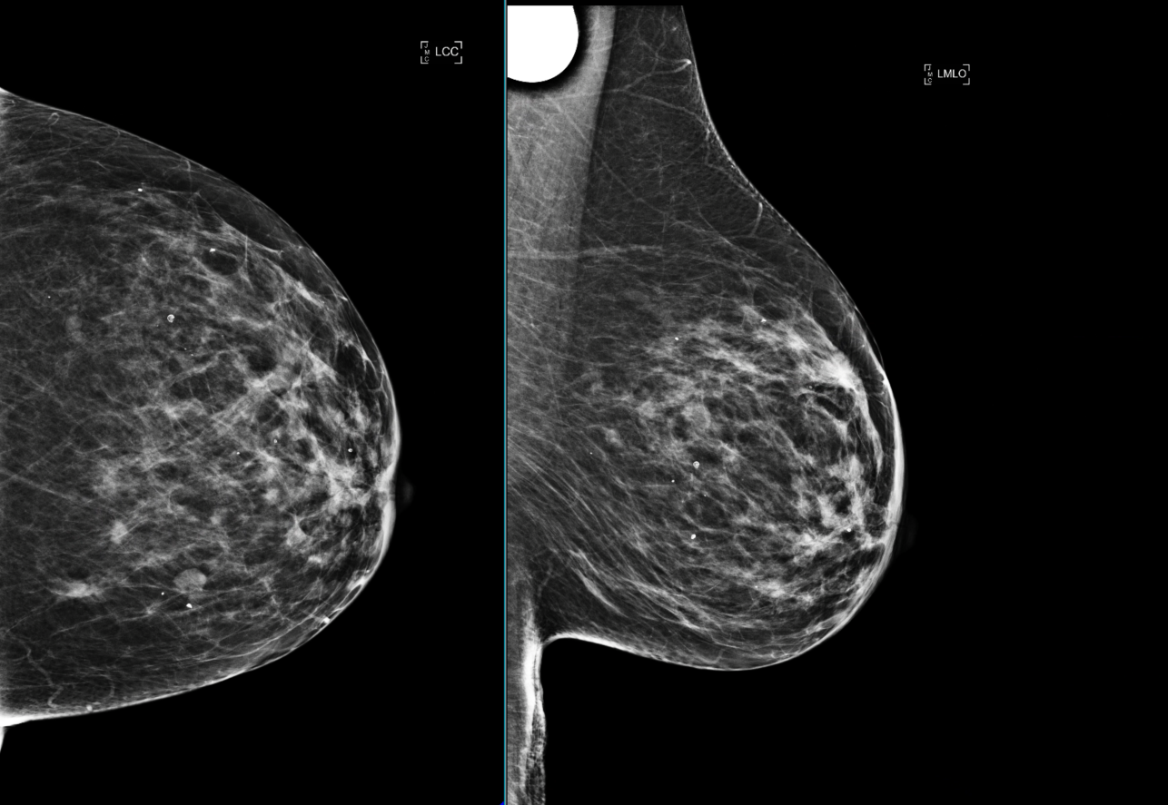
Methods
Lesion Identification
2011
2012
2013
Lesion based analysis
Lesion not visible
Screen detectable
Screen detectable
Notes:
that retrospective review by experts of the images containing cancerous lesions is inherently biased, this was done purely to guide annotation of images, then to allow testing of the AI which interpreted all consecutive screens in the study, so the method to test the AI was not biased

Slide 7
Methods
Final status label assignment
2011
2012
2013
Lesion based analysis
Structured dataset
Cancer Negative
Cancer Positive
Cancer Positive

Slide 8
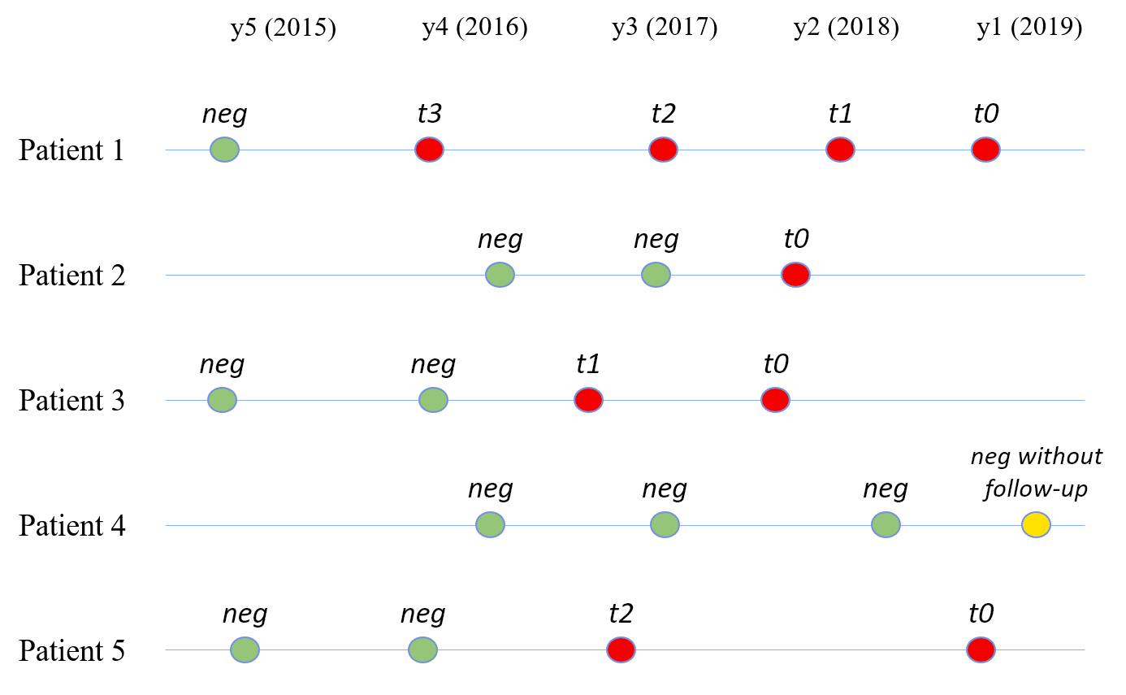
Methods
Time index assignment
Lesion based analysis
Structured dataset
Performance on early detection

Slide 9
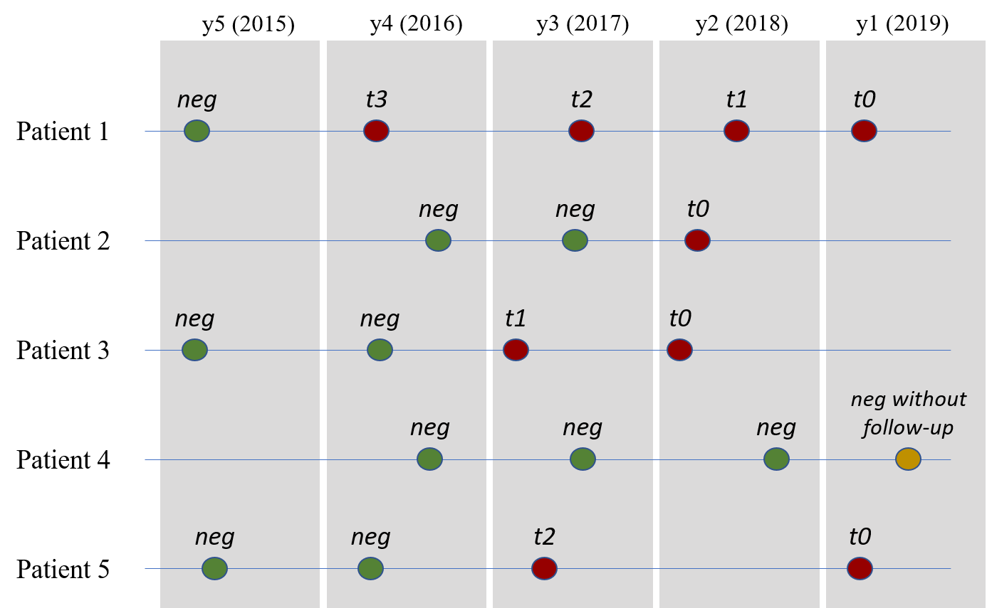
Methods
Time windows definition
Lesion based analysis
Structured dataset
Performance on early detection
Results generalization
Avoid bias towards AI

Slide 10
Methods
Time windows definition
Lesion based analysis
Structured dataset
Performance on early detection
Results generalization
Avoid bias towards AI
Generalizable results
CDR and RR evaluation
AI predictions
Yearly basis evaluation
Weighted average among time windows
MammoScreen v1.2 (Therapixel)

Slide 11
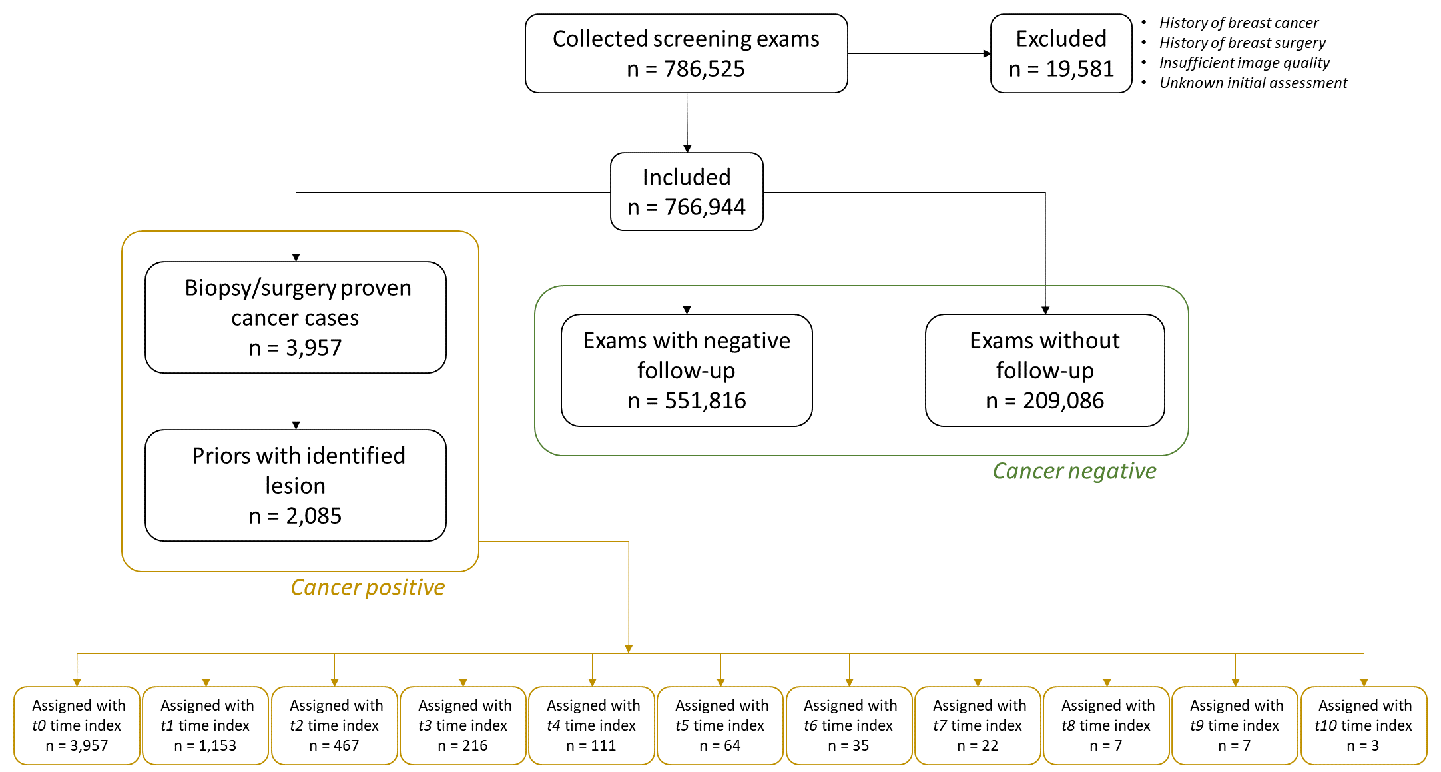
Results – Data Collection and Structuring
Data from 2 US centers (2006 – 2019)
766,944 (222,862 patients) included exams
6,042 examinations labeled as cancer positive
45% (1153) of cancers visible 1 year before
21% (467) of cancers visible 2 years before
t0
n = 3,957
t1
n = 1153
t2
n = 467
t3
n = 216
t4
n = 111
t5
n = 64
t6
n = 35
t7
n = 22
t8
n = 7
t9
n = 7
t10
n = 3
Notes:
seven hundred sixty thousand examinations
two hundred twenty thousand patients

Slide 12
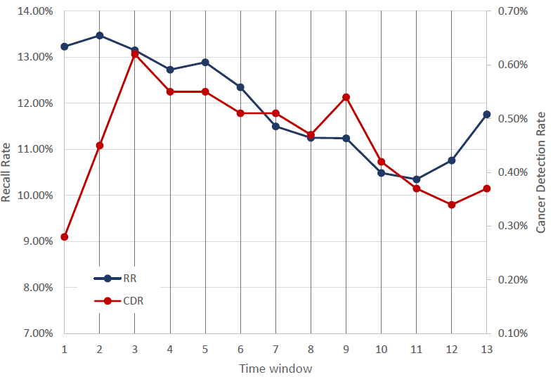
Results – AI Performance
13 time windows
Average AI CDR 4.8/1000
Average AI RR 12.15%
42% of cancers detected by the AI one year before
38.5% of cancers detected by the AI two years before
Average AI+human CDR 5.3/1000
Average AI+human RR 9.7%
2019
2006

Slide 13
Key Points
Evaluation of AI’s performance on consecutive mammograms with a natural prevalence of breast cancer
Conventional metrics (Recall Rate and Cancer Detection Rate)
Assess AI’s ability to detect breast cancer at an early phase

Slide 14
Limitations
Device not designed for standalone use
Version of the algorithm not able to process prior examinations
Version of the algorithm processing 2D only (FFDM and SM)

Slide 15
Future Steps
Updated version of the algorithm
Prospectively explore the real AI/human interaction

Slide 16
Thank You
spacile@therapixel.com

